Slide 1
Operations Report
BMW Company

Slide 2

Introduction.
Bayerische Motoren Werke (BWM) is a German founded automobile engineering company.
BMW is best known for its excellence in manufacturing and production of cars and motorcycles.
Majority of BMW products are shipped under the BMW Motorrad.
The automobile segment deals with the development, manufacturing, assembling, as well as selling of cars (Tate, Bals, & Ellram, 2018, P. 20).
Notes:
Bayerische Motoren Werke (BWM) is a German founded automobile engineering company. Currently, BMW is best known for its excellence in manufacturing and production of cars and motorcycles. Majority of BMW products are shipped under the BMW Motorrad Tate, Bals, & Ellram, 2018, P. 20).. The company operates varied business segments which include motorcycles, automotive, financial services, in addition to other key segments. The motorcycle department pays attention to the provision of premium services. The automobile segment deals with the development, manufacturing, assembling, as well as selling of cars under different brands with BMW inclusive (Tate, Bals, & Ellram 2018).

Slide 3
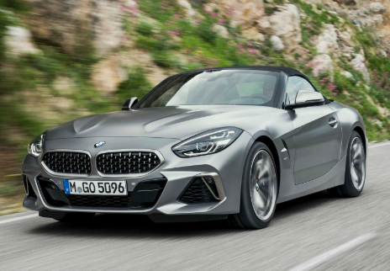
Background of the BMW Company
The BMW company was established in 1916 by Franz Josef Popp, Karl Rapp, and Camilo Castiglioni.
BMW is headquartered in Munich, Bavaria (Tate et al., 2018, P. 45).
In 1917, the company endeavored to manufacture aircraft.
The company shifted to produce motorcycles in 1923, and later on, the production of automobiles in 1928 (Tate et al., 2018)
In 2012, the BMW company was highly embraced and listed as one of the most reputable companies in the world by Forbers.com after holding about 60% of the total surveys.
Notes:
The BMW company was established in 1916 by Franz Josef Popp, Karl Rapp, and Camilo Castiglioni. It is headquartered in Munich, Bavaria (Tate et al. 2018). Since its establishment, the company has made an effort to become one of the most reputable top performers in the automobile industry. In 1917, the company endeavored to manufacture aircraft. However, in 1918, the company was forced to shift from aircraft-engine production as a requirement from the terms and conditions of the Versailles Armistice Treaty, an aspect which occurred as a result of Germany loss during the World War I. Due to this challenge in producing aircraft-engine, the company shifted to produce motorcycles in 1923, and later on, the production of automobiles in 1928 (Tate et al. 2018). In 2012, the BMW company was highly embraced and listed as one of the most reputable companies in the world by Forbers.com after holding about 60% of the total surveys. Currently, the company manufactures a varied of BMW model cars which include BMW M3, BMW X3, BMW Z4, and BMW Concept X6 Active Hybrid. The company also offers a variety of vehicle spares and financial services in the wider automobile market.

Slide 4
Operations Strategies of BMW.
Operations Report on BMW Company (HRC)
  The BMW Group has maintained its focus towards increased success in the automobile industry.
  The Human-Robot Collaboration technology at BMW has hardly outperformed the greatest proportion of all-robot and all-human teams
BMW’s Mission Statement
  To become the world's foremost provider of premium products as well as premium services for individual mobility in the year 2020 (Tate et al., 2018).
BMW’s Core Competencies.
  Effective brand management and outstanding design (Bollig, Ardey, & Sautter, 2015)
  BMW has accessed significant leadership competence in the global market.
  BWM has also attained competence through product differentiation.
  BWM’s competence has been defined by profitability trend
Notes:
The Human-Robot Collaboration technology at BMW has hardly outperformed the greatest proportion of all-robot and all-human teams, an aspect which has reduced human idle time in the company by 84% (Tate, Bals, & Ellram, 2018, P. 20).
The BMW mission is “to become the world's foremost provider of premium products as well as premium services for individual mobility in the year 2020" (Tate et al., 2018).
The BMW is aligned with two core strategies; that is, to be profitable and to cultivate long-term value from technological, structural as well as cultural perspectives.
BMW competencies include attained through effective brand management in conjunction with outstanding design (Bollig, Ardey, & Sautter., 2015). The firm has been committed to developing innovative technologies for future products and services. From another point of view, BMW has accessed significant leadership competence in the global market, an aspect which has been developed through increased focus in penetrating the premium market segment as well as an acute understanding of the customer’s emotional aspects into BMW automobiles. Further, BWM has also attained competence through product differentiation. As evident, the automobile industry has been overcrowded with many top performing products from other companies such as Mercedes and hence effective product differentiation is the only probable technique which would relieve the company from stiff competition and help in accessing the anticipated competence. In addition, the BWM’s competence has been defined by profitability trend within the business and the automobile industry as well.

Slide 5
BMW’s Operations Process.
Flowchart for the BMW company production process.
The Chassis Production Unit.
The Electro-Coating.
The surface finish center.
The Pre-Asssembly
The Final Assembly Line
Notes:
Step 1: The Chassis Production Unit.
Car’s frame is comprised of aluminum rather than steel, an aspect which makes the body increasingly stiffer and saves the car’s weight. Car’ frame is comprised of over 2000 welds in this stamp, and only qualified workers at BMW are eligible for performing it.
Step 2: The E-Coating Process.
Electro-coating takes place after chassis production. The frame is moved to another Unit where it is protected from rust. It is the immersed in chemicals where it is roasted in 360 degrees to get coated from both sides.
Step 3: The surface finish center
In this step, workers are mandated to major on components of the car like the engine, instrumental panel, and doors. Moreover, the worker’s polishes the body and outlines the perfect finish.
Step4: The Pre-Assembly
In this step, workers are mandated to major on components of the car like the engine, instrumental panel, and doors.
Step 5: The Final Assembly
The final assembly line is sanctioned into seven core units.
Unit 1: The engineers fixes blocks of high-density foam as well as thin soundproofing materials to prevent varied frequency sounds.
Unit 2: Wiring is done all over the frame to enable powering a well as controlling all the electronic components of the car.
Unit 3: Technicians in this section are committed to installing strong as well as stiff instrument panel made of cast magnesium whose weight does not exceed fifteen pounds.
Unit 4: Unit 2 qualified technicians join efforts to attach the engine to the chassis, thus, linking the heart to the body.
Unit 5: Specialists are mandated to install the car’s windows and windshields manually.
Unit 6: Acute fixing of seats.
Unit 7: Car wheels are mounted, and alignment testing is done. Other tests such as sideslip test, suspension test, head lighting tests, engine drum test, and the break tests are done at this step.

Slide 6
Continuation on BMW Operations Process …
b. BMW company’s inventory policy.
  Raw materials are managed through careful examination based on the budgeted cost of inputs against what has been purchased as raw materials.
  Managers are committed to ensuring close monitoring of employee in conjunction with accurate guidance while on duty for good process inventory.
  The company has adopted an effective inventory software system known as STASAM which compares the results of all estimation methods in each inventory (Tate, Bals, & Ellram, 2018).
c. HRC Sustainability in Operations.
  Minimization the negative effects on the environment. Technology.
  Electrification and innovations.
  Role model for other global companies by accessing full green electricity
Notes:
Inventory management is a highly underscored element in the context of BMW. The company advocates for a high level of accountability and transparency. Raw materials are managed through careful examination based on the budgeted cost of inputs against what has been purchased as raw materials. In regards to work in process inventory, managers are committed to ensuring close monitoring of employee in conjunction with accurate guidance while on duty. This practice enables employees to remain focused on the firm’s strategic objectives (Tate, Bals, & Ellram, 2018). More importantly, the company has adopted an effective inventory software system known as STASAM which compares the results of all estimation methods in each inventory.
Through HRC, engineers have been able to minimize the negative effects on the environment. Technology has enabled the extension of the earliest phases of production to the repossessing and reusing of material at the end of the vehicle life. HRC has paved the way for electrification and innovations which are particularly relevant for climate protection. Through HRC, the firm strives to exist as a role model for other global companies by accessing full green electricity operations by 2020.

Slide 7
Quality at BMW.
a). Quality of manufacturing.
  The BMW Group is very much responsive to the customer’s expectations.
  It underscores on the aspect of professionalism for quality customer services.
  The company has increasingly relied on HRC technology to ensure increased productivity (Wheaton & Schrott., 2018).
  The BMW Group has been characterizing by good team culture which keeps employees motivated to work towards customer satisfaction.
  The company has opted for unending research and development as a basis for innovations.
Notes:
It underscores on the aspect of professionalism for quality customer services. The company has increasingly relied on HRC technology to ensure increased productivity, an aspect which has paved the way for digitalization of services as per the customer expectations (Wheaton & Schrott., 2018). More importantly, the BMW Group has been characterizing by good team culture which keeps employees motivated to work towards customer satisfaction. Also, the company has opted for unending research and development as a basis for innovations.

Slide 8
Continuation on Quality at BMW
b) The BMW builds on quality in varied ways.
  BMW assigns great importance to comprehensive quality assurance stretching from the development stage of vehicle.
  BMW has effective quality management system that voluntarily requires the BMW centers to assess every operation practice (Mariel & Minner, 2015).
  BMW Group has an ISO certificate which certifies that the company complies with the demanding targets.
c) BMW TQM tools.
  The BMW Group is increasingly expanding to produce a wide range of products.
  BMW has launched a stream of innovative products as a basic tool in the automobile market (Wheaton & Schrott, 2018).
  The company has availed logistic concerns to the purchase, the handle, the inventory management, and storage as well as methods of administration of sales.
  BMW’s logistic activity has been committed to ensuring the proper flow of an organization with the aim of availing necessary resources the corresponding needs.
Notes:
The company has adopted a fully effective quality management system that voluntarily requires the BMW centers to assess every operation practice, every production procedure and every job description throughout the leadership (Mariel & Minner, 2015). Everyone is examined on improvement while focusing on changes that need to be made to increase effectiveness and efficiency. BMW assigns great importance to comprehensive quality assurance stretching from the development stage of vehicle suspension, beginning with the testing of individual suspension components such as helical compression springs. The most significant components include characteristic spring curves, distribution of resulting forces and intersection points (Wheaton & Schrott, 2018). BMW Group has an ISO certificate which certifies that the company complies with the demanding targets defined during development for the environmental impacts during sourcing, production, usage, and subsequent recycling.
The BMW Group is increasingly expanding to produce a wide range of products considerably while consolidating its global market position. BMW brand is valued as the best in the world, and the company has persistently made efforts to launch a stream of innovative products as a basic tool in the automobile market (Wheaton & Schrott, 2018). Further, the company has availed logistic concerns to the purchase, the handle, the inventory management, and storage as well as methods of administration of sales. Wheaton & Schrott (2018, p. 40) states that BMW’s logistic activity has been committed to ensuring the proper flow of an organization with the aim of availing necessary resources the corresponding needs.

Slide 9
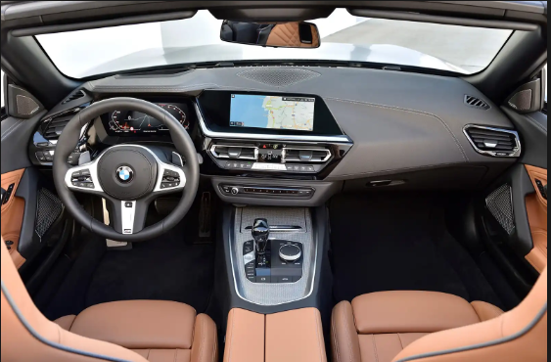
BMW’s Capacity Planning.
HRC requires higher initial capital investments.
Overreliance of HRC might lead to the creation of poor quality products due to the lack of proper inspection for technical errors made by robotics.
HRC technology has substantiated decline in skilled manpower in the company.
Assembly lines cannot be modified fully to fit the HRC based practice and hence leading to inflexibility in production.
Notes:
HRC requires higher initial capital investments. Overreliance of HRC might lead to the creation of poor quality products due to the lack of proper inspection for technical errors made by robotics. HRC technology has substantiated decline in skilled manpower in the company. Assembly lines cannot be modified fully to fit the HRC based practice and hence leading to inflexibility in production.

Slide 10
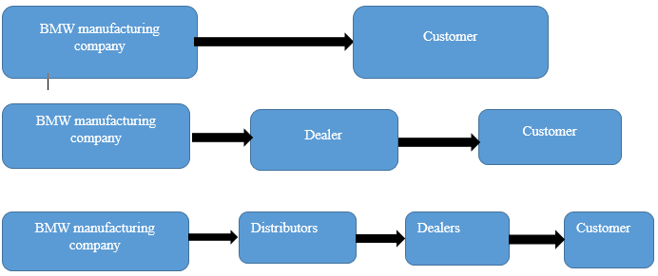
BMW Supply Chain.
BMW’s major supply chains.
Notes:
Information from the plays a core role in enhancing BMW’s operation process and increased profitability. Data from the supply chain helps the company to identify new target market in the global market. It helps in ascertaining customers’ expectations and hence establishing a basis for total quality improvement. Further, data from this chain helps in identification of the most cost-effective mode of product distribution, thus, paving the way for profit maximization. It allows suppliers to choose the chain which covers the bigger pool of customers. The company is quite reflective of the demand and cash flow in the chain. It is believed that when demand is high, the rate of cash flow in the supply chain is likely to be high leading to improved operation.
The logistics team is mandated to ensure persistent supply of goods and services to the customers of the global market. The BMW proficient logistics ensures accurate delivery of goods and services at the right time.

Slide 11
Conclusion.
BMW is among the top performing companies based on the current trends in the automobile industry.
BMW has maintained focus on the quality of products and services as well as the need to meet customer expectations.
The company operations are complemented with new strategies which aligns with the HRC technology and future BMW (Mariel & Minner, 2015).
Every firm should have a production planning capacity to complement its goals and objectives.
There is a need to emphasize on the quality of the product in relation to customer expectations.
BMW should deploy its efforts in research and development.
Notes:
it is worth to assert that BMW is among the top performing companies based on the current trends in the automobile industry. The company through its reliable operations management has maintained focus on the quality of products and services as well as the need to meet customer expectations. The company operations are complement with new strategies which aligns with the HRC technology and future BMW. This study has been very informative. As such, every firm should have a production planning capacity to complement its goals and objectives (Mariel & Minner, 2015). There is a need to emphasize on the quality of the product in relation to customer expectations. It is worth to recommend that BMW should deploy its efforts in research and development to examine and establish potential solutions to ever-changing customer expectations.

Slide 12
Bibliographies.
Bollig, M., Ardey, N. and Sautter, M., 2015. The BMW Power E Drive Concept’s Drivetrain. MTZ worldwide, 76(10), pp.4-9.
Kallich, S., Graf, H., Schaller, K.V. and Ritter, S., 2019. The New BMW Motorrad Boxer Engine with ShiftCam Technology. MTZ worldwide, 80(4), pp.32-39.
Mariel, K. and Minner, S., 2015. Strategic capacity planning in automotive production networks under duties and duty drawbacks. International Journal of Production Economics, 170, pp.687-700.
Tate, W., Bals, L. and Ellram, L. eds., 2018. Supply Chain Finance: Risk Management, Resilience and Supplier Management. Kogan Page Publishers.
Wheaton, B. and Schrott, B., 2018. Total Quality Management. Theory and Practice: Englischsprachiger Text mit zweisprachigem Index. Walter de Gruyter GmbH & Co KG.

